Slide 1

#FormulaAIHack
ExponentialRacingAI
Team Submission
23/02/2022

Slide 2
Introductions
Hello and welcome to FormulaAIHack 2022
We are Nnamse Akpan from South Africa, Qasid Ali from Pakistan and myself Danielle Danielle Alice Desanges Aucéane THIAM MÉKÀ de GOGUENHEIM from Cameroon and our Team is Exponential Racing AI.
With use cases ranging from Formula One Race track engineers to Game Simulations, Machine Learning Models can predict and correlate a range of weather conditions, which can impact a driver’s training and performance, as well as the automobile. Granular insights are required in the form of predictive data to make accurate decisions.

Slide 3
Solutions
RacingMet Analysis, is a solution which uses machine learning algorithms to predict weather conditions, then describe their impact on the car and the driver and prescribe actions to be taken, with an accuracy of 96 percent.
We were tasked to apply Machine Learning Models to a dataset provided during the Hackathon. We used Oracle Analytics Cloud to clean, train and apply 2 different Machine Learning Models in order to provide the most insightful data possible. We chose Random Tree Multi-classification for it's ability to quickly correlate and classify data according to required parameters and a Linear Regression model for its granular forecasts.
Method of Operation:
In OAC , the Data Flows are created by inserting the dataset, filtering and cleaning outliers or errors, applying classification, and finally the chosen Oracle Machine Learning Model is applied and predictive insights can be visualized.. These processes have real world applications where granular prescriptive AI output is required for Decision Support Systems and Pitch Engineers.
It delivers a simpler , No-Code environment for planning , creating and implementing data analytics to improve efficiency by preemptively providing relevant and valid data.

Slide 4
Method
Process Flow in OAC
Load data
Clean data
Create Data Flow
Train Machine Learning Model
Apply Machine Learning Model
Perform prediction
Prescriptive automated insights
Visualization

Slide 5
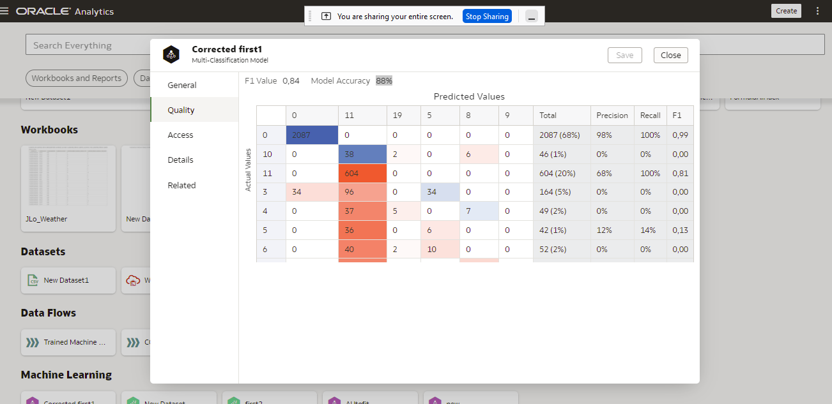
Model Accuracy

Slide 6
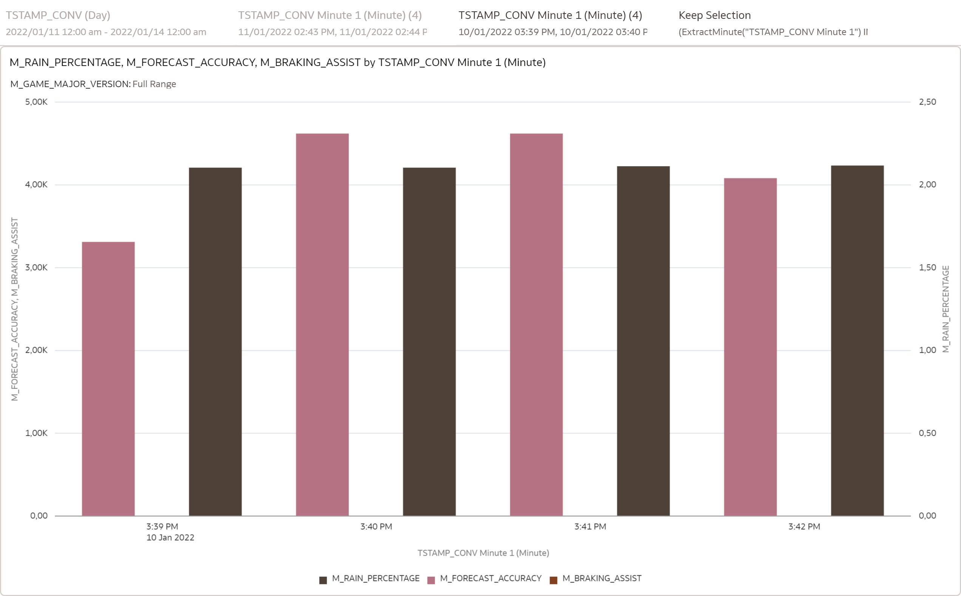
Model Output

